Slide 1
News Image Classification
CS 640 Project 2 Topic 2
By: Maya Shen, Rongyu Wang, Jerry Wu

Slide 2
Problem Definition
Nowadays journalists are not the first ones to record an emergency event but any civilians with phones, and they send to social media almost immediately when such event takes place in their proximity.
For this project, we build a system that looks for such event in a pool of images originated from social media feeds; the system consists of two parts:
Deep Neural Network trained for object detection
Expert System that yields an emergency level score based on the object(s) detected from images.

Slide 3
Background & Baseline
Original Paper and Method Reproduction (Acc: 94%)
Transfer Learning on Single Class Classification
Fine Tuning (86%)
Fixed Feature Extractor (84%)
Transfer Learning on Multi-label Detection (bounding box is a more functional approach ; ))

Slide 4
Improvement
Before Training: Dataset Quality
During Training: Parameter Tuning
After Training: Extra Functionalities
Simple Expert System
Crowd Detection

Slide 5
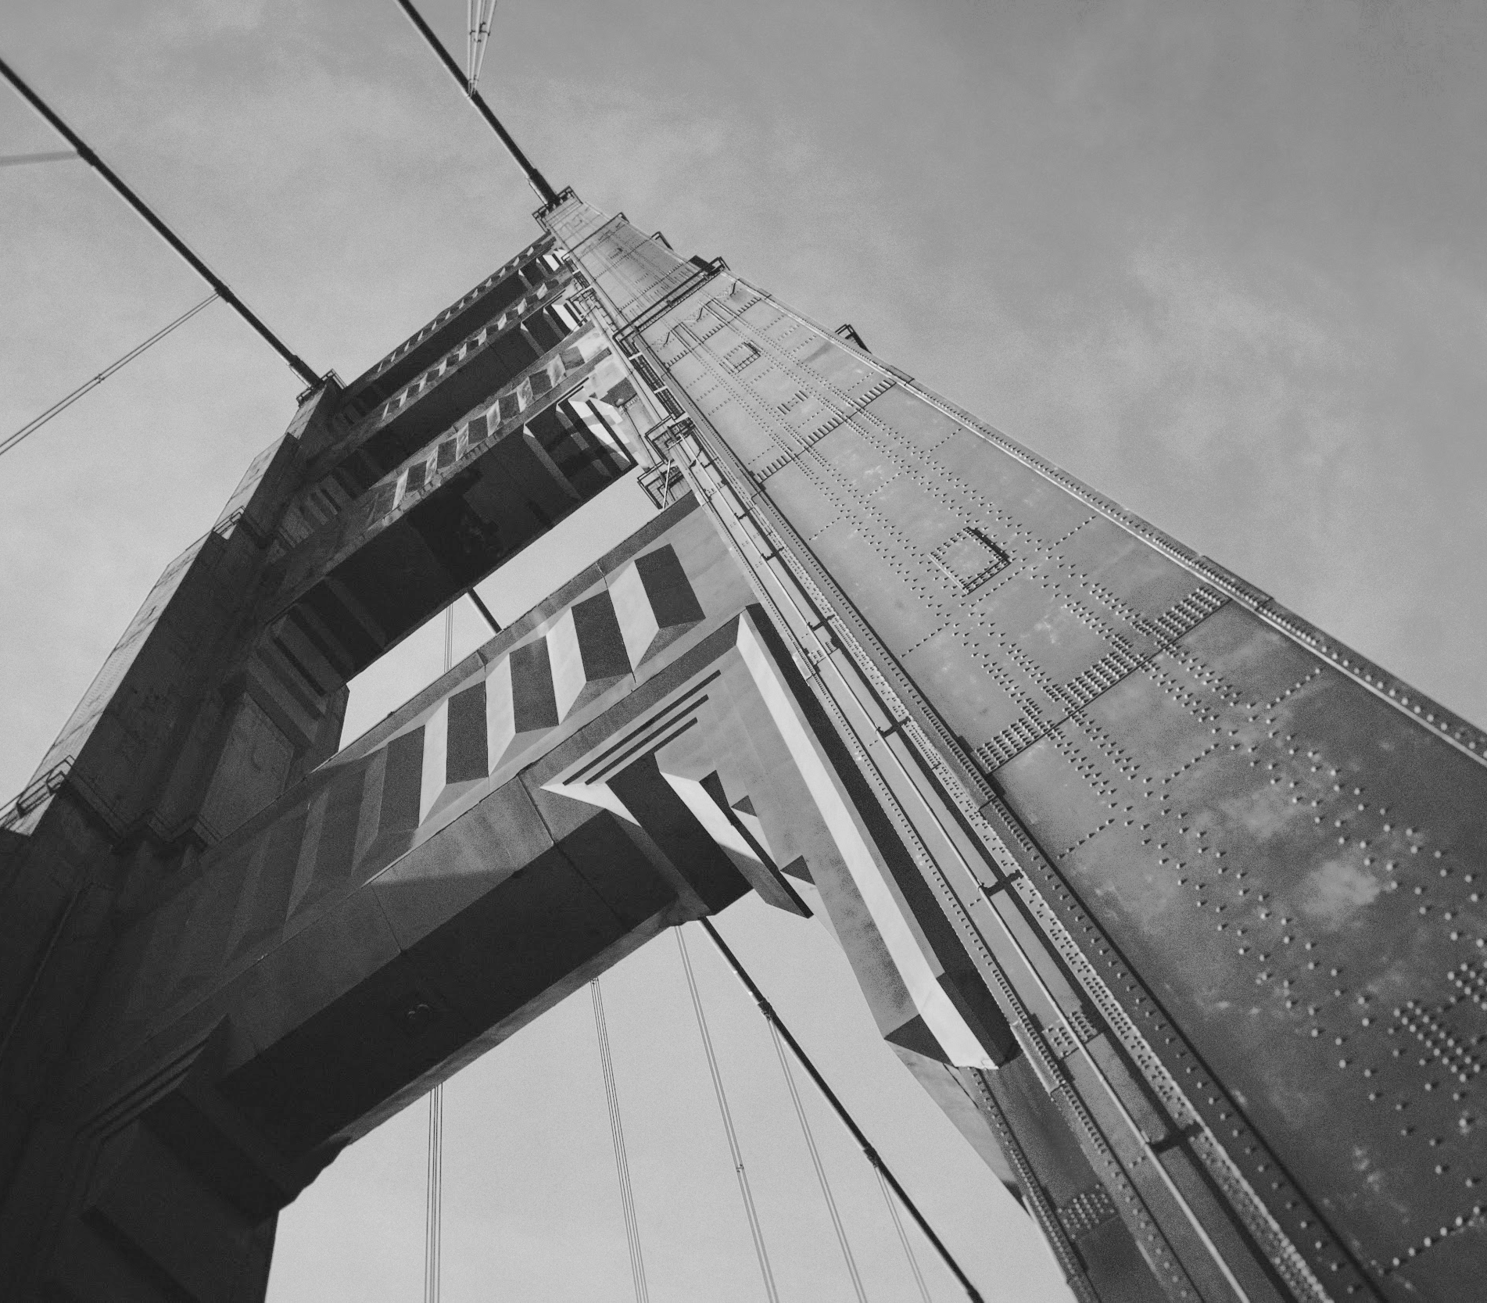
Thanks!

